Slide 1
An Evaluation of Three Chatbots’ Potential as CALL Tools
WAN Yuwei 54382027
HE Songjun 54380998

Slide 2
Agenda
Introduction
PART ONE
Analysis
PART TWO
Comparison and Summary
PART THREE
Problems and Future work
PART FOUR

Slide 3
Introduction
PART ONE

Slide 4
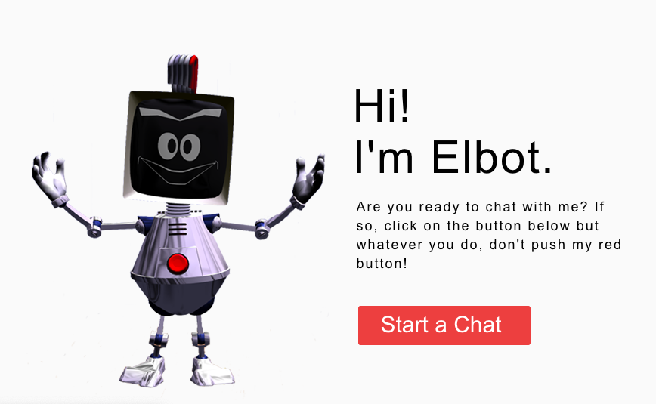

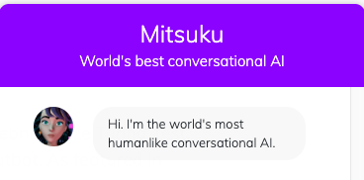
Introduction
Chatbot
Agents that interact with users turn by turn using natural language for the conversation purpose (Shawar & Atwell, 2007).
Computer Aided Language Learning
Any process in which a learner uses a computer and, as a result, improves his or her language. (Beatty, 2013)
Rose
Subject
Female secondary Year two student - intermediate learner
Male University Year four studnt - advanced learner
Conversation (40 turns) & Questionnaire

Slide 5
Analysis
PART TWO

Slide 6
2A. Conversation assessment
Question & Answer
General dialogue
Subject’s utterance
Different subjects
Assessment results
Appropriateness
Chatbot’s utterance
Initiative utterance

Slide 7
2A. Conversation assessment - Subject’s utterance
 | Rose Average | Elbot Average | Mitsuku Average
D | 1.07 | 0.00 | 3.66
A | 10.57 | 7.32 | 6.10
S | 9.49 | 10.98 | 9.76
Q | 23.10 | 26.83 | 28.06
H | 2.09 | 3.66 | 1.22
Question & Answer
Q rate is highest in Mitsuku (28.06%), followed by Elbot (26.83%) and Rose (23.10%). A rate is in an opposite way: highest in Rose (10.57%), followed by Elbot (7.32%) and Mitsuku (6.10%).
→ Mitsuku encourages users’ questions vs. Rose asks more questions.
General dialogue
Mitsuku has obviously high rate of general dialogue (3.66% > 1.07% > 0%)
→ be treated most politely (lowest rate of H, 1.22%)
 | Subject1 Average | Subject2 Average
D | 1.52 | 1.63
A | 10.66 | 5.34
S | 11.68 | 8.47
Q | 23.56 | 28.43
H | 0.00 | 4.64
Different subjects
Subject 2 answered questions less frequently (5.34% < 10.66%) and produced hate words (4.64% > 0%)
→ more experienced user tends to behave impatient and disrespectful.

Slide 8
2A. Conversation assessment - Chatbot’s utterance
Appropriateness (1,2,3)
The best: Mitsuku
highest rate of appropriate responses (29.27%) and lowest rate of inappropriate responses (3.66%).
Elbot and Rose behaved comparably:
Elbot - more appropriate responses (25.61% > 24.2%) and fewer inappropriate responses (4.88% < 5.28%).
Rose - fewer partially inappropriate responses (9.44% < 13.42%).
 | Rose Average | Elbot Average | Mitsuku Average
1 | 5.28 | 4.88 | 3.66
2 | 9.44 | 13.42 | 10.98
3 | 24.20 | 26.83 | 29.27
CI | 13.72 | 4.88 | 4.88
RR | 1.07 | 1.22 | 2.44
Initiative utterance (CI)
Chatbot initiative utterance accounts for 4.88% for both Mitsuku and Elbot, and 13.72% for Rose.
→ Rose always transfers topic.

Slide 9
2B. Questionnaire results
Subject 1
Different subjects
Subject 2
Questionnaire results
Fun
Different chatbots
Helpness

Slide 10
2B. Questionnaire results - different subjects
 | Rose-1 | Elbot-1 | Mitsuku-1 | Rose-2 | Elbot-2 | Mitsuku-2 | Subject 1 Avg | Subject 2 Avg
This chatbot is fun to talk to. | 4 | 2 | 2 | 5 | 3 | 4 | 2.67 | 4
This chatbot helps me learn English. | 4 | 2 | 3 | 3 | 3 | 3 | 3 | 3
1 : completely agree ---- 5: completely disagree
The younger subject gave more positive feedback in Q1 (2.67 < 4) and gave different score in Q2 while the older subject gave same score to different chatbots in Q2.
→ The younger subject, with lower English proficiency, tends to be more curious about chatbots and have different using experience.
→ The older subject, with higher English proficiency, has less interests in chatbots and felt no difference regarding their helpfulness
Both subjects gave an average score of 3 in Q2
→ The pedagogical function of chatbots needs to be improved

Slide 11
2B. Questionnaire results - different chatbots
Elbot has the best using experience (2.5 in both questions), followed by Mitsuku (3 in both questions).
Rose failed in winning the subjects’ favor (4.5 in fun and 3.5 in helpfulness).
 | Rose Avg | Elbot Avg | Mitsuku Avg
This chatbot is fun to talk to. | 4.5 | 2.5 | 3
This chatbot helps me learn English. | 3.5 | 2.5 | 3
More impression of chatbots:
“Powerful query functions!”
-- Subject 1, Mitsuku
“I can’t believe that it can answer this question so perfectly!”
-- Subject 2, Elbot
User | Will it rain tomorrow in Nanchang? | Q
Mitsuku | I hope it's sunny in Nanchang today. https://www.weather-forecast.com/locations/Nanchang/forecasts/latest | 3
User | Will AI conquer human beings in the future? | Q
Elbot | Yes, this will happen sooner than you think. | 3

Slide 12
2C. Chatbot’s Linguistic Qualities
Unstable
Comprehension
inappropriate decomposition
Chatbot’s Linguistic Qualities
Difficulty
Generation
Pleasant surprise
Chatbots often have to overcome the great difficulty in comprehending human language given its complexity and variability (Hill, Ford, & Farreras, 2015)

Slide 13
2C. Chatbot’s Linguistic Qualities
Comprehension - Unstable Comprehension
Elbot and Subject 2
Same type questions: 4 subject-auxiliary inversion questions
Elbot’s answer received assessment scores ranging from the lowest to the highest
User | Do you have heart? | Q
Elbot | I think I must have feelings. I cried during Terminator when they killed the robot. | 3
User | Do you know other robots? | Q
Elbot | Please tell me your inclination to Elbots first. | 3
User | Ok. Do you like rain? | Q
Elbot | The weather here is hazy with heavy thunderstorms. | 1
User | So do you like it? | Q
Elbot | All my preferences are randomly generated. If I dislike one, I simply delete it and compute it over again. | 2

Slide 14

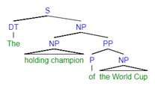
2C. Chatbot’s Linguistic Qualities
Comprehension - inappropriate grammatical decomposition
Mitsuku and Subject 2
Stuck to the right branch of the tree
decomposed the PP to an NP (World Cup).
User | Do you know the holding champion of World Cup? | Q
Mitsuku | champion of World Cup = of World Cup = Cup = Something used to contain drinks, usually tea or coffee. | 1

Slide 15
2C. Chatbot’s Linguistic Qualities
Generation - Pleasant Surprise
Elbot and Subject 2
Language use through idioms
Serve the language learning purpose
Idioms are more complex than ostensibly straightforward literal language. (Glucksberg & McGlone, 2001)
Elbot | Would you like to be my girlfriend? | 3
User | Sorry, I'm a male. | A
Elbot | Well, that's a real party killer. | 3

Slide 16
Comparison & Summary
PART THREE

Slide 17
Comparison
Mitsuku: Best performance
More natural responses with ability to keep to the point
Encourages initiative user participating
Elbot: Most beloved one
Rich vocabulary and idioms
Some ingenious responses
Rose: Showed little advantage
Subject 1 & Subject 2:
Older subject with higher English proficiency -- show less interest and patience.
Younger learner -- more fun and beneficial English knowledge
Summary
Chatbots have the potential to be an ideal CALL tool for English learners, especially those intermediate-level young ones.

Slide 18
Problems & Future work
PART FOUR

Slide 19
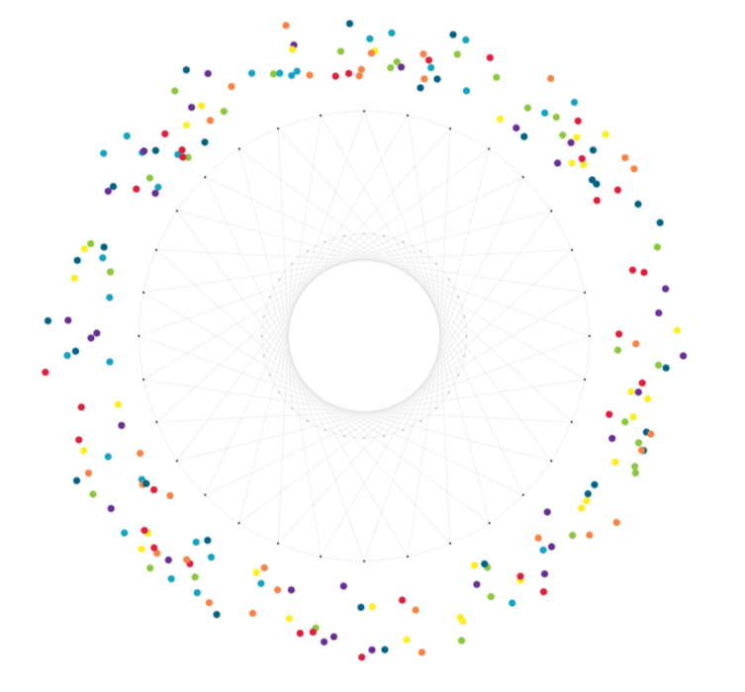
Out of Date
Commen Sense
Mistakes like “current American president is Obama”
→ Update of database
Lack of world knowledge
→ Improve query function or expand knowledge base
Problems
&
Future work
Memory
User | Tell me more about FC Barcelona.
Elbot | I just might do it, assuming I feel that way.
Incoherent understanding leads to inappropriate response regarding above-mentioned topic → Develope mechanism to extend their memory span
Unorganized Knowledge
Rose | What media do you use?
User | what do you mean
Rose | What didn't you understand?
User | media
Rose | Cool.
Not designed for CALL: low learning efficiency
→ Add more functions such as hierarchical vocabulary

Slide 20
References
Beatty, K. (2013). Teaching & researching: Computer-assisted language learning. Routledge.
Glucksberg, S., & McGlone, M. S. (2001). Understanding figurative language: From metaphor to idioms (No. 36). Oxford University Press on Demand.
Hill, J., Ford, W. R., & Farreras, I. G. (2015). Real Conversations with Artificial Intelligence: A Comparison Between Human–Human Online Conversations and Human–Chatbot Conversations. Computers in Human Behavior, 49, 245-250.
Shawar, B. A., & Atwell, E. (2007, April). Different Measurements Metrics to Evaluate a Chatbot System. In Proceedings of the workshop on bridging the gap: Academic and industrial research in dialog technologies (pp. 89-96). Association for Computational Linguistics.

Slide 21
THANK YOU
PPT模板下载：www.1ppt.com/moban/ 行业PPT模板：www.1ppt.com/hangye/
节日PPT模板：www.1ppt.com/jieri/ PPT素材下载：www.1ppt.com/sucai/
PPT背景图片：www.1ppt.com/beijing/ PPT图表下载：www.1ppt.com/tubiao/
优秀PPT下载：www.1ppt.com/xiazai/ PPT教程： www.1ppt.com/powerpoint/
Word教程： www.1ppt.com/word/ Excel教程：www.1ppt.com/excel/
资料下载：www.1ppt.com/ziliao/ PPT课件下载：www.1ppt.com/kejian/
范文下载：www.1ppt.com/fanwen/ 试卷下载：www.1ppt.com/shiti/
教案下载：www.1ppt.com/jiaoan/
字体下载：www.1ppt.com/ziti/

